Slide 1
Ryu Optical SDN User Guide
Jiakai Yu
University of Arizona

Slide 2
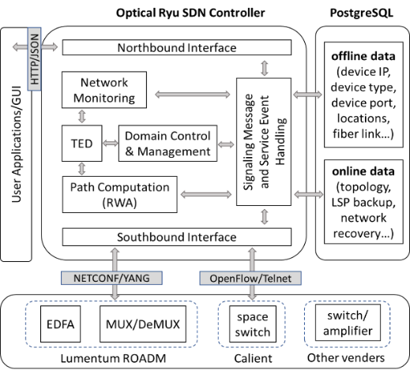
Optical SDN/NFV
SDN controller:
Interfaces for users & devices
Network monitoring
Network control & management
Path computation
Database:
Traffic Engineering Database (TED) for real-time computing with memory r/w
PostgreSQL for data record with hard disk w/r

Slide 3
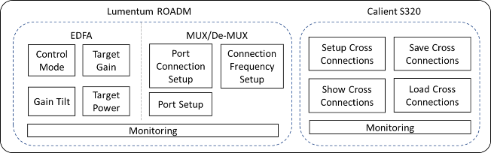
Optical SDN/NFV
Optical Layer NFV:
ROADM-WSS: NETCONF/YANG
ROADM-EDFA: NETCONF/YANG
Space switch: OpenFlow/SSH/Telnet
Modules:
WSS: Port setup, Cross-connection setup, Wavelength channel setup
EDFA: Gain/Tilt adjustment, Gain mode selection, Constant gain/power
Space switch: Cross-connection setup, Topology saving/loading
Monitoring: ROADM and Space Switch

Slide 4
Northbound and Southbound Interface
WSGI is the northbound interface, using HTTP protocol and JSON data format for communication between users and SDN controller.
POST request event to SDN controller via JSON data format.
{“request_type” : “request type”,
“source_node_id” : “1”,
“source_node_port” : “3”,
“destination_node_id” : “4”,
“destination_node_port” : :3”,
“start_freq” : “196825.25”,
“end_freq” : “196875.25”,
“direction” : “uni-direction”,
“username” : “admin”,
“password : “admin”}
Southbound interface is using NETCONF protocol via ncclient package.
JSON data format
{“key” : “value”, “key” : “value”}
Users
HTTP
JSON
port 8080
Web Server Gateway Interface (WSGI)
Northbound Interface
SDN controller core
Southbound Interface
NETCONF

Slide 5
Control Logic with Events
Monitor
Amplifier
Single ROADM
Configure
Traffic Engineering Database (TED)
Configure
MUX/DEMUX
Monitor
Lumentum ROADM-20
Northbound Interface
Souhbound Interface
event
Tear connection
Multiple ROADMs
Add connection
Wavelength Routing Algorithm (RWA)

Slide 6
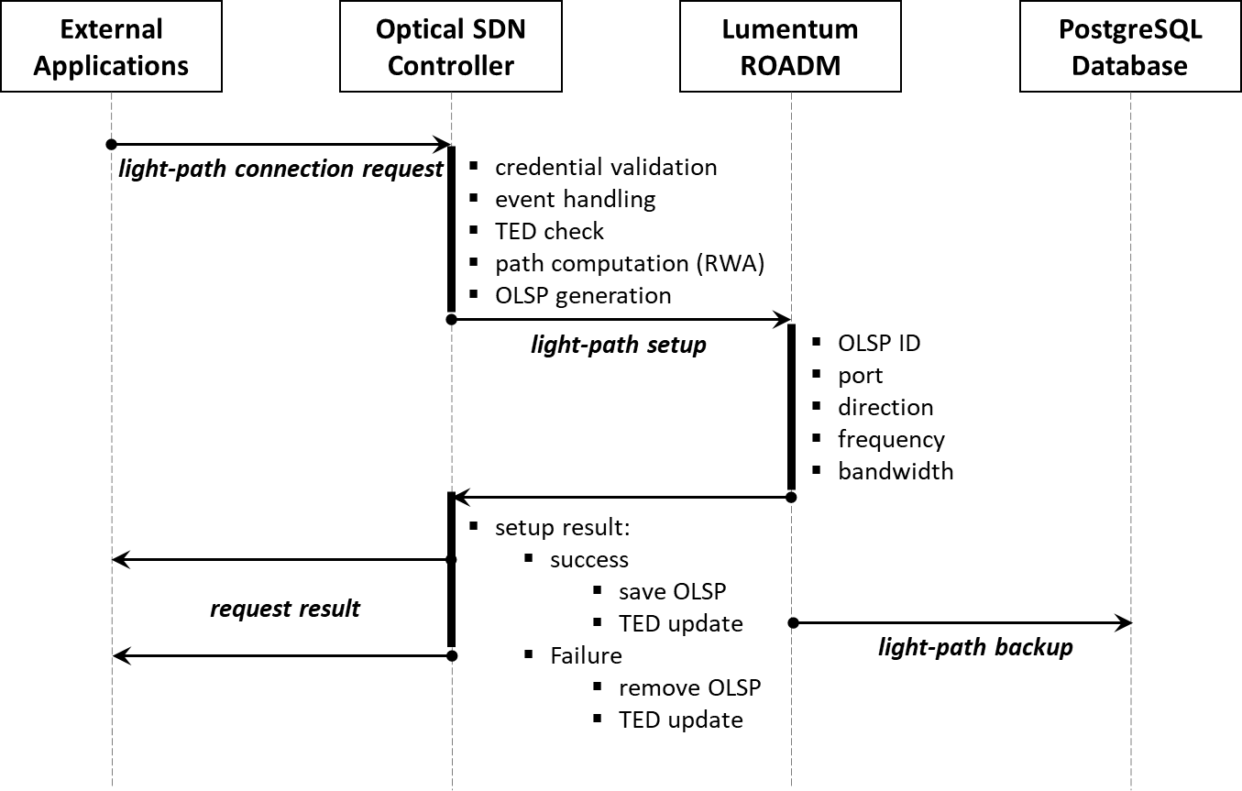
1. Light-path setup with wavelength routing assignment
Operation types:
Light-path setup
Space switching
Connection types:
Lumentum ROADM
Calient S320
SDN OLSP types:
Protected
Unprotected
Main modules :
TED/PostgreSQL
Resource reservation
RWA
NOTICE: SDN OLSP is not the conventional LSP method. It is a labeled switched light-path used in SDN controller management.

Slide 7
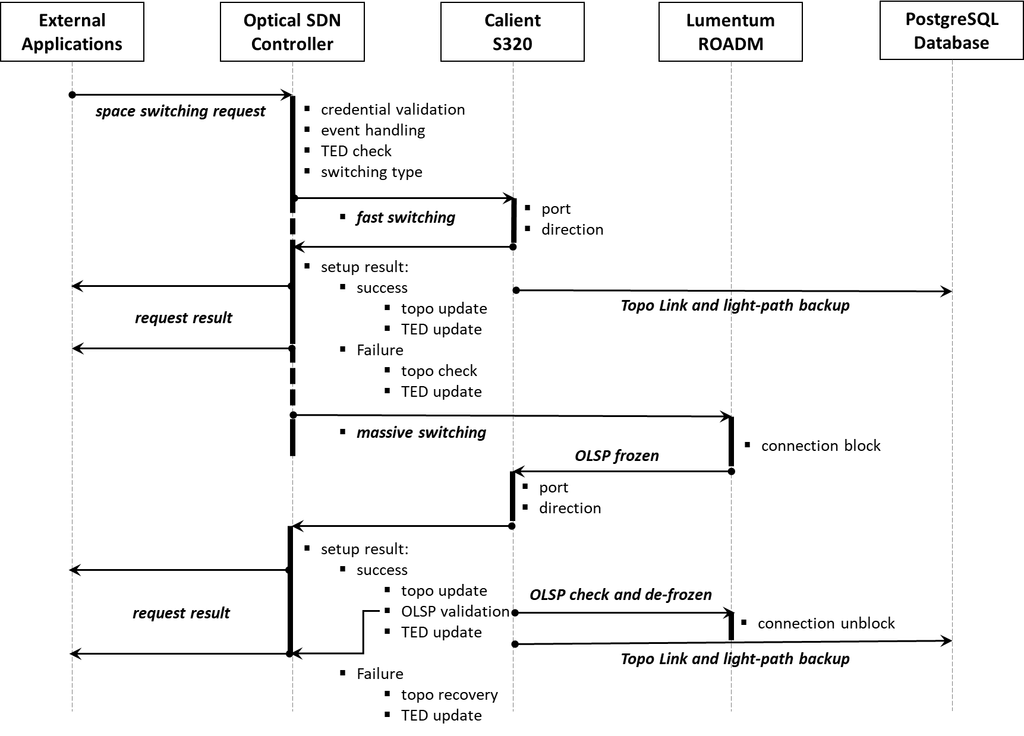
2. Space switching for network topology reconfiguration with service availability detection

Slide 8
Python Coding Functions
Northbound Interface
<nothbound_message_sending.py>, <northbound_message_receiving.py>
Control Logic
<path_computation.py>, <intra_domain_connection.py>
Wavelength Routing Algorithm (RWA)
<path_computation.py>, <RWA_shortestpath_random.py>
Traffic Engineering Database (TED)
<database.py>, <initialization.py> , <common.py>, <init_files>
Souhbound Interface
<lumentum_NETCONF.py>, <calient_telnet.py>
<southbound_message_receiving.py>
Control Events
<custom_event.py>

Slide 9
Request JSON format
All JSON format requests should be sent to the SDN server set up on localhost:8080 (template use: send.py)
Add a light-path through multiple ROADMs with RWA
{"Request_Class": "AddPathConnection",
“direction": “bi-direction", # bi-direction or uni-direction
"source_node_ip": "10.104.1.4",
"source_node_port": "1", # 20 ROADM ports, id 1-20 (only 4 connected to Calient)
"destination_node_ip": "10.104.1.3",
"destination_node_port": "1",
"connection_name": "comsmos",
"connection_id": “1", # 96 wavelength channels, id 1-96
"channel_id": “25", # 96 wavelength channels, id 1-96
"username": “**", # Lumentum ROADM username
"password": “**"} # Lumentum ROADM password

Slide 10
Tear down a light-path through multiple ROADMs with RWA
{"Request_Class": "TearPathConnection",
"connection_id": "62", # target teardown connection id
"direction": "bi-direction", # bi-direction or uni-direction
"username": “**", # Lumentum ROADM username
“password”: “**"} # Lumentum ROADM password
Monitor WSS connection information of a ROADM
{"Request_Class": "MonitorWSS",
"node_ip": "10.104.1.1", # Target ROADM IP
“username”: “*", # Lumentum ROADM username
“password”: “**"} # Lumentum ROADM password

Slide 11
Configure a single ROADM WSS connection
{"Request_Class": "ConfigWSS",
"node_ip": "10.104.1.2",
"name": "cosmos",
"module_id": 2, # MUX and De-MUX, id 1 and 2
"connection_id": 1, # 96 channels, id 1-96, or ‘all’
"input_port": 5101, # De-MUX input id 5101, MUX input id 4101
"output_port": 5203, # De-MUX output id 5201-5220, MUX output id 4201-4220
"start_freq": 194600.00, # WSS channel start frequency
"end_freq": 194650.00, # WSS channel end frequency
"attenuation": 4.0, # channel attenuation 0-20 dB
"status": "in-service", # in-service or out-of-service
"block": "false", # channel signal block status: true or false
“username”: “**", # Lumentum ROADM username
“password”: “**"} # Lumentum ROADM password

Slide 12
Monitor EDFA information of a ROADM
{"Request_Class": "MonitorEDFA",
"node_ip": "10.104.1.2",
"username": “**",
"password": “**"}
Configure a ROADM EDFA
{"Request_Class": "ConfigEDFA",
"node_ip": "10.104.1.2",
"module": 1,
"ctrl_mode": "constant-gain", # control mode: constant-gain or constant-power
"gain_mode": "high-gain", # gain mode: high-gain or low gain
"target_power": -3, # target power value, if constant-power is enabled
"target_gain": 23, # target gain value, if constant-gain is enabled
"tilt": 0, # gain tilt value
"ALS": False, # automatic laser shutdown: True or False
"status": "in-service", # working status: in-service or out-of-service
"username": “**",
"password": “**"}

Slide 13
Set up cross-connections in Calient S320
{"Request_Class": "SetupCRS",
"authentication": "***", # Calient authentication info
"crs": ["5.7.6>5.8.5","5.7.7>5.8.6"]} # ‘>’ is uni-direction, ‘-’ is bi-direction
Tear down cross-connections in Calient S320
{"Request_Class": "TeardownCRS",
"authentication": "***",
"crs": ["5.7.6>5.8.5","5.7.7>5.8.6"]} # ‘>’ is uni-direction, ‘-’ is bi-direction
Get all cross-connections in Calient S320
{"Request_Class": "GetTopo",
"authentication": "***"}

